Slide 1
Encrypting Machine
Final Project CS2810
Team Members: Carlos Rubio & Stephanie Gregory

Slide 2

What does it do?
Generate Caesar Cipher code
Encryption by shifting right one alphabetical letter
Decryption by shifting left one alphabetical letter

Slide 3
Features
Encryption mode is selected with the number 1 after being prompted
Decryption mode is selected with the number 2 after being prompted
You will enter three letters and receive three letters back that have shifted one letter right or left depending on what you have selected.

Slide 4
Main Program
Initializes registers
Prints welcome message
Select encrypt or decrypt
Input message
Input key
Encrypt or decrypt
End subroutine

Slide 5
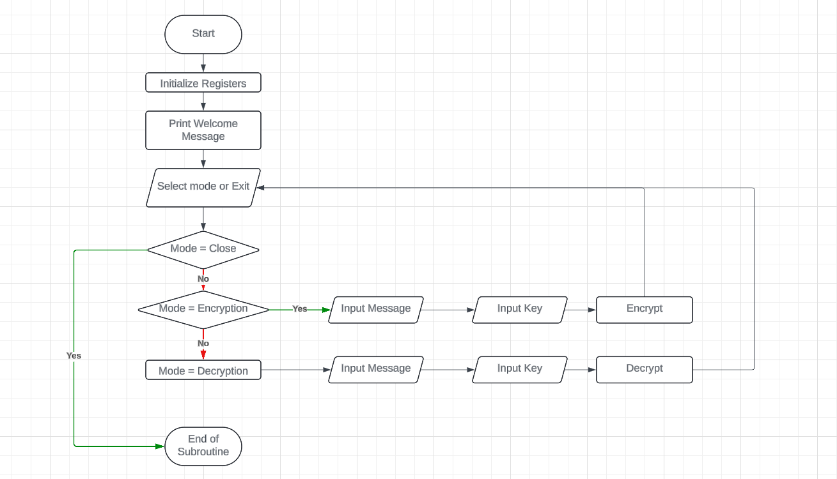
Flowcharts
Main Routine

Slide 6
Selection
Input Character
Enter 0, error message
Enter 1, convert to binary, add one for encryption
Enter 2, convert to binary, subtract one for decryption

Slide 7
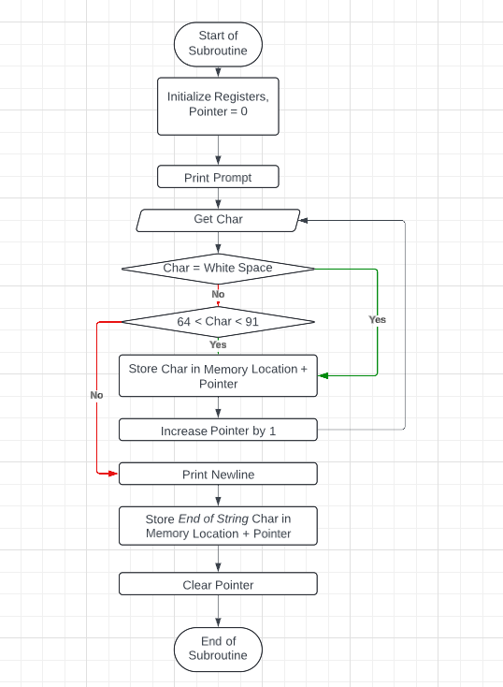
FlowChart
Input String Message

Slide 8
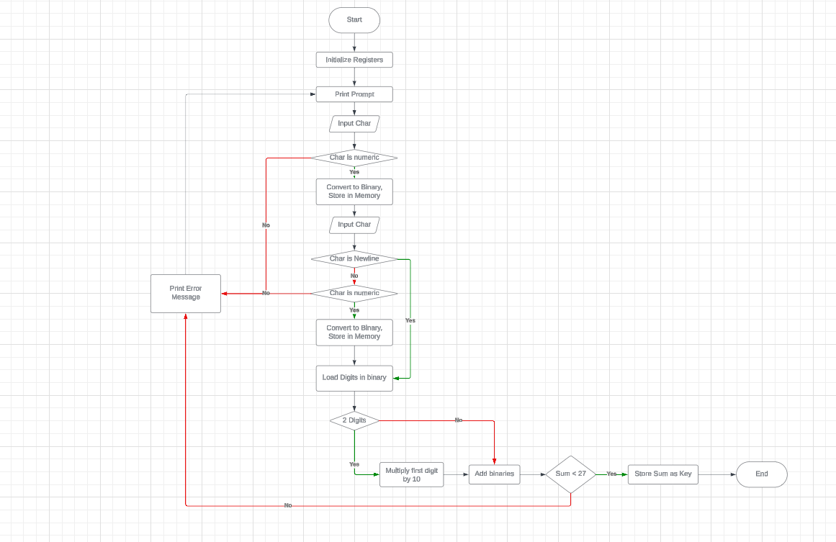
Flowchart
Input Key

Slide 9
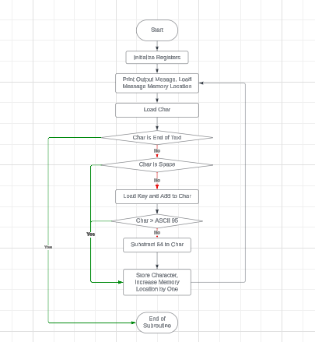
Flowchart
Return Encrypted/Decrypted Message

